Slide 1
PhD Chapter Survey 2024

Slide 2
Focus of survey
In the spring of 2024 the PhD Chapter conducted a survey to cover topics missed in the 2023 survey.
2023 Survey (40% response rate)
32% have faced issues moving up the ladder 🡪 Decided to invesitage the matter futher!
This survey includes:
Salary Ladder
Vacation and Sick leave
Labor Unions
On-boarding, Reception and Chapter Hall
PhD Ombudsman

Slide 3
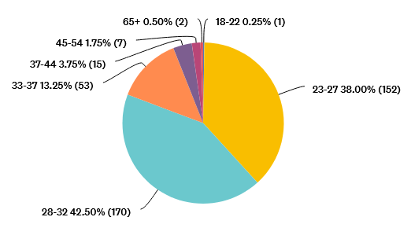
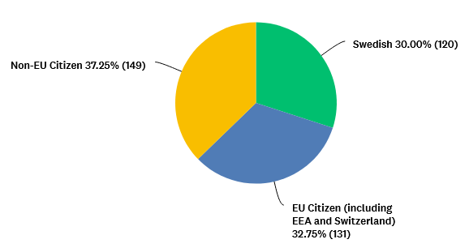
Our Student Sample (analysis)
400 responses ≈ 30% of total PhD students
The sample is divers in citizenship, year started, as well as over all schools.
Most students are member of THS and around half are a member of a trade union
Citizenship:
Age:

Slide 4
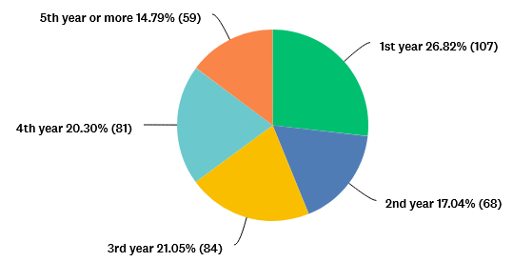
Our Student Sample (data)
In which year:
1st year (started less than 12 months ago)
2nd year (started between 12 and 24 months ago)
3rd year (started between 24 and 36 months ago)
4th year (started between 36 and 48 months ago)
5th year or more (started more than 48 months ago)

Slide 5
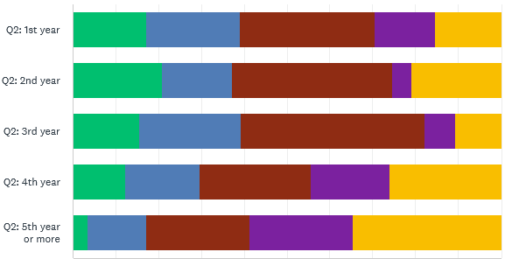
Our Student Sample (data)
In which year:
Correlation by school:
ABE
CBH
EECS
ITM
SCI
0
10
20
30
40
50
60
70
80
90
100

Slide 6
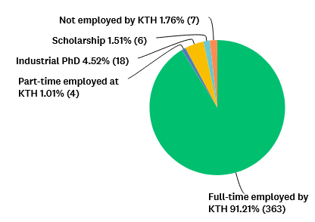
Our Student Sample (data)
Finances:
Full-time employed by KTH as a doctoral student, FOFU-Ingenjör or between contracts (more than 80% employment).
Part-time employed at KTH (less than 80%).
Industrial doctoral student (i.e., employed by another company)
Scholarship (i.e., foreign government, EU grant with no employment status, etc).
Not employed by KTH (i.e., joint-programmes, time-limited exchange, or just not employed at all).

Slide 7
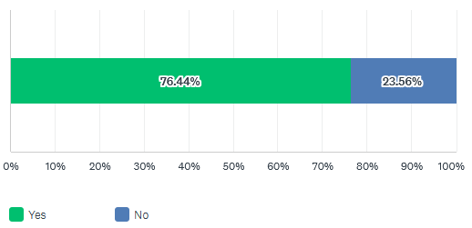
Student Union (data)
Q7: Are you currently a THS member?

Slide 8
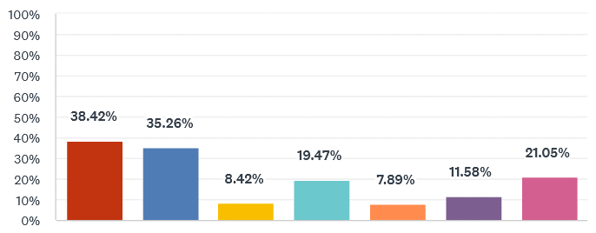
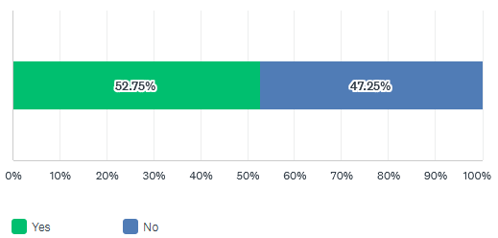
Labour Unions (data)
Q8: Why are you not a member of a Labour Union? (Select all that apply)
Q6: Are you currently a member of a trade union? Do not mistake the Labour Unions for the Student Union at KTH (THS)! Example of Trade Unions are SULF, Engineers of Sweden (Sveriges Ingenjörer) and ST.
No one told me to be a member / I didn't know it existed
I do not know what a trade union is for / what it does
There are no relevant benefits in associating to one
I do not perceive their work as being useful
I do not want to pay the monthly fee
I will not stay in Sweden after my studies
There are no reasons at all for me to be a member
Other (please specify)
People are mainly in the process of still choosing the right one or planning to join one soon

Slide 9
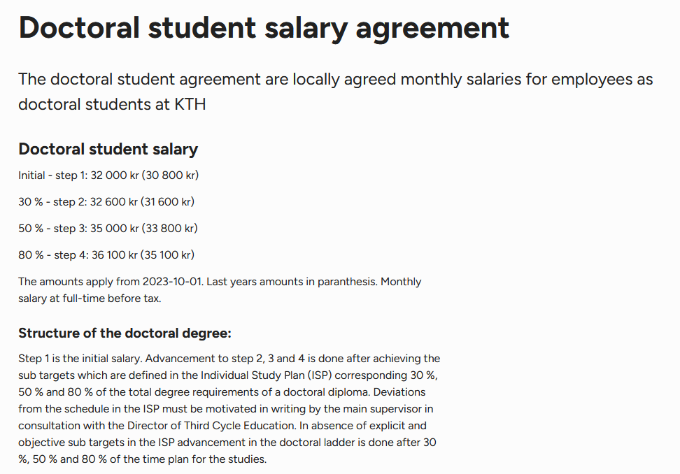
PhD Salary Ladder
Current System: Requirements stated in ISP or time based

Slide 10
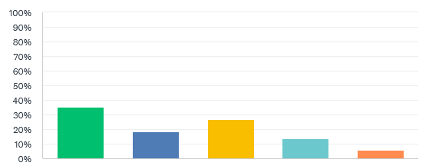
Salary Ladder Step (data)
Q9: In which step of the salary ladder are you currently? For scholarship students, the values described are tax-free.
Initial (Employed: 32 000 kr, Scholarship: 25 400 kr)
30% (Employed: 32 600 kr, Scholarship: 25 800 kr)
50% (Employed: 35 000 kr, Scholarship: 27 500 kr)
80% (Employed: 36 100 kr, Scholarship: 28 300 kr)
Other (please specify, for example, if you have a different salary for being an industrial PhD, or receive a value different than the ones formally established in the salary ladder)
Mainly industrial PhD students and some other people that don’t have a contract at KTH.

Slide 11
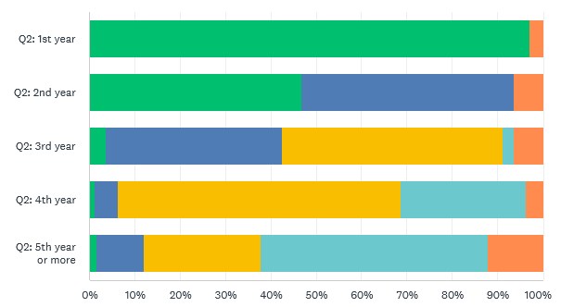
Salary Ladder Step (data)
Correlation by year a PhD student is in:
Initial
30%
50%
80%
Other

Slide 12
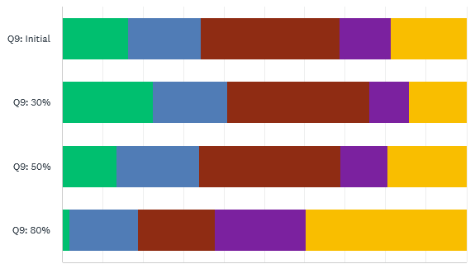
Salary Ladder Step (data)
Correlation by school:
Distribution of each step per school Percentage breakdown, not absolute values.
ABE
CBH
EECS
ITM
SCI
Initial
30%
50%
80%
Other
Current year of PhD Student
ABE
CBH
EECS
ITM
SCI
0
10
20
30
40
50
60
70
80
90
100
0
10
20
30
40
50
60
70
80
90
100

Slide 13
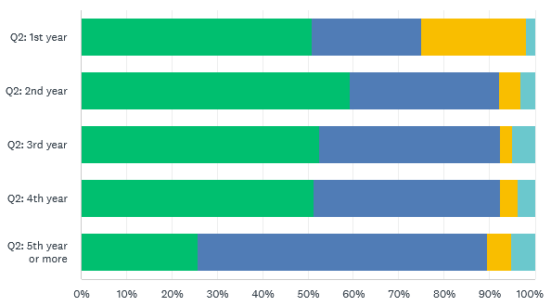
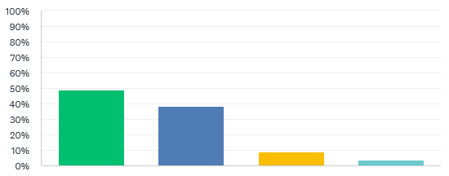
Criteria PhD salary ladder (data)
Correlation by year a PhD student is in:
Q10: Do you believe that you have a well-defined criteria to achieve in your ISP to move up on the salary ladder?
Yes
No
No ISP
Not applicable

Slide 14
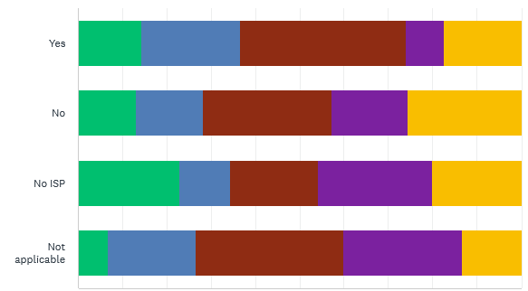
Criteria PhD salary ladder (data)
Correlation by school:
Q10: Do you believe that you have a well-defined criteria to achieve in your ISP to move up on the salary ladder?
ABE
CBH
EECS
ITM
SCI
Yes
No
No ISP
Not applicable
0
10
20
30
40
50
60
70
80
90
100

Slide 15
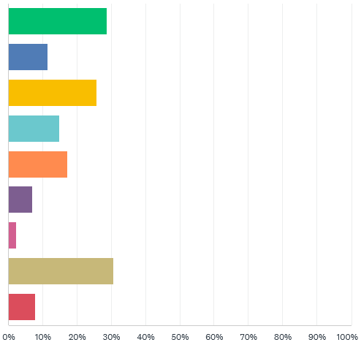
Criteria PhD salary ladder (data)
Q11: Are there any institutional requirements (even if unofficial) from your department or division for you to go up on the ladder? (Select all that apply)
Yes, a public seminar
Yes, a formal meeting with a committee and/or my supervisor
Yes, a number of publications (submitted or accepted)
Yes, a number of credits
Yes, I get promoted at a specific time of my studies
Yes, but these requirements applies only for certain steps
Yes, and my division/department skips the progression for certain steps
No criteria established
Not applicable for me

Slide 16
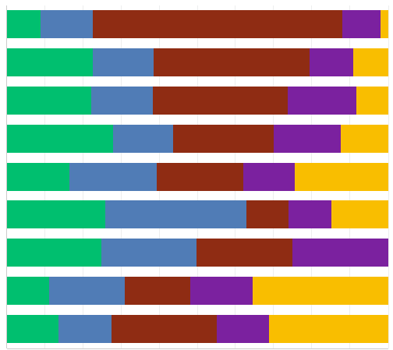
Criteria PhD salary ladder (data)
Correlation by school:
ABE
CBH
EECS
ITM
SCI
Yes, a public seminar
Yes, a formal meeting with a committee and/or my supervisor
Yes, a number of publications (submitted or accepted)
Yes, a number of credits
Yes, I get promoted at a specific time of my studies
Yes, but these requirements applies only for certain steps
Yes, and my division/department skips the progression for certain steps
No criteria established
Not applicable for me
0
10
20
30
40
50
60
70
80
90
100

Slide 17
Criteria PhD salary ladder (data)
Q12: leave a commentary if you desire.
70+ responses
Summary:
Some students are still discussing the criteria with their supervisor
It’s not always clear what the requirements are/students are not well informed
When requirements are defined in the ISP, they are not always followed strictly and leads to the PhD students having to ask for salary increase
Students seem to think that it is unfair that the supervisor has a say in the salary increase/think they have too much power and neglect the salary ladder

Slide 18
Criteria PhD salary ladder (data)
~38% of PhD students that are in their 5th year or more, are still in 2nd step or below of their PhD salary ladder
Some students (~ 9%) don’t have an established ISP
~38% of PhD students think that they don’t have clear criteria for advancing in the PhD salary ladder

Slide 19
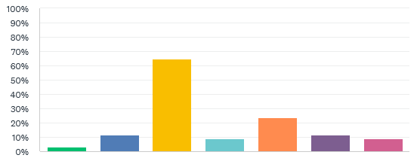
eISPs –Why don’t you have one? (data)
Q13: In a previous question, you checked that you do not have an ISP established. Please select the reason why you don't have one. According to the Higher Education Law, all doctoral students are entitled to a regularly updated Individual Study Plan.
None of the above
My supervisor doesn't care about it / want to me have one
I am a new student / It's in process of being established
I don't care about it
It takes too long to establish one / It has been held by a third-party (Director of Third-Cycle studies or Human Resources) during the process
I do not know how to make an eISP (lack of information)
I didn't have time to do one

Slide 20
eISPs –Why don’t you have one? (analysis)
The most common reason why students don’t have an ISP established yet is because they are new students and it’s in the process of being established
Other students don’t have an ISP because it takes too long to create one, or their supervisor doesn’t want them to have one, or because of lack of information or they feel they don’t have time to establish one
Q14: leave a commentary if you desire.
8 responses
Summary:
Some students think it’s a waste of time/get no help
It’s being established soon

Slide 21
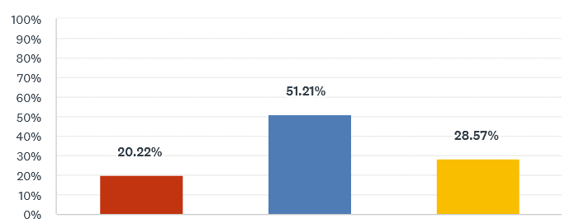
Issues with Ladder (data)
Q15: Did you have any issues going up on the PhD Ladder?
Yes
No
Not applicable

Slide 22
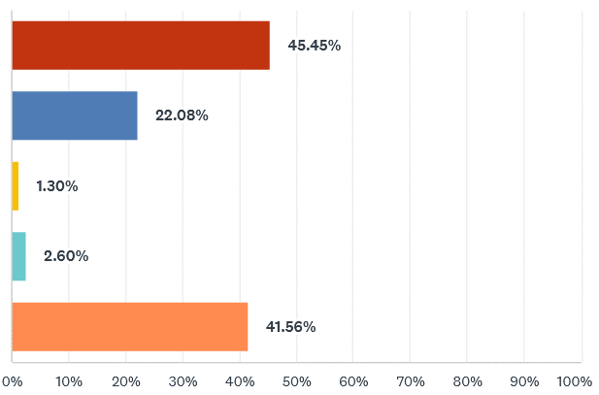
Resolving PhD Salary Ladder Issues (data)
Q16: As you selected that you had problems moving up on the salary ladder, what were the reason(s) behind these issues? (Select all that apply)
My supervisor explicitly didn't let me to go forward on the salary ladder, for any reason
The criteria set by the division
The human resources didn't want me to go up
The Director of Third-Cycle (FA) blocked my progress
None/Other

Slide 23
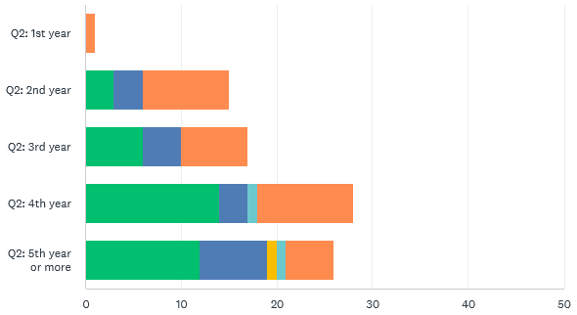
Resolving PhD Salary Ladder Issues (data)
Correlation by year a PhD student is in:
My supervisor explicitly didn't let me to go forward on the salary ladder, for any reason
The criteria set by the division
None/Other
The human resources didn't want me to go up
The Director of Third-Cycle (FA) blocked my progress

Slide 24
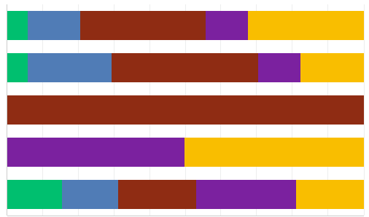
Resolving PhD Salary Ladder Issues (data)
Correlation by school:
ABE
CBH
EECS
ITM
SCI
My supervisor explicitly didn't let me to go forward on the salary ladder, for any reason
The criteria set by the division
The human resources didn't want me to go up
The Director of Third-Cycle (FA) blocked my progress
None/Other
0
10
20
30
40
50
60
70
80
90
100

Slide 25
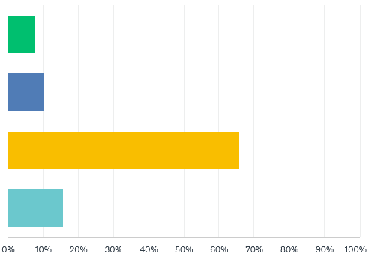
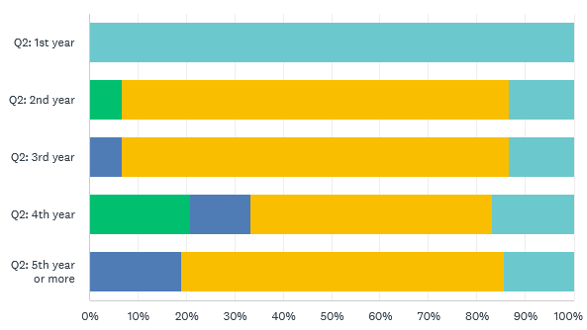
Resolving PhD Salary Ladder Issues (data)
Q17: Did you try to contact the Human Resources (HR) regarding these issues?
Correlation by year a PhD student is in:
Yes, and I was given support
Yes, and this didn't solve anything
No, I thought it wouldn't solve the issue / I didn't want to bother with it
No, I do not know who to contact

Slide 26
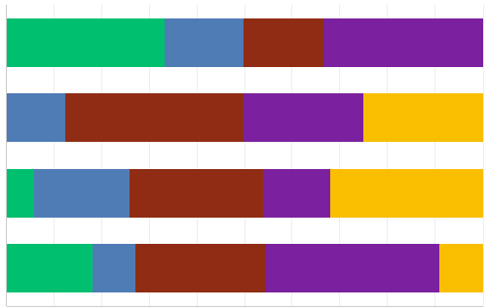
Resolving PhD Salary Ladder Issues (data)
Q17: Correlation by school:
ABE
CBH
EECS
ITM
SCI
Yes, and I was given support
Yes, and this didn't solve anything
No, I thought it wouldn't solve the issue / I didn't want to bother with it
No, I do not know who to contact
0
10
20
30
40
50
60
70
80
90
100

Slide 27
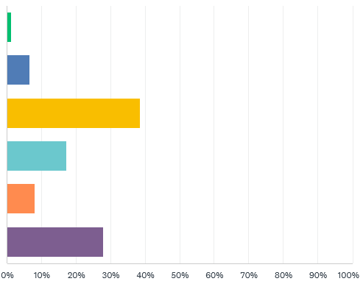
Resolving PhD Salary Ladder Issues (data)
Q18: Did you try to contact your local trade union (Saco-S/ST/Sulf/Sveriges ingenjörer) regarding these issues?
Yes, and I was given support
Yes, and this didn't solve anything
No, I thought it wouldn't solve the issue / I didn't want to bother with it
No, I did not know they could help me
No, I do not know who to contact
I'm not a member of a trade union

Slide 28
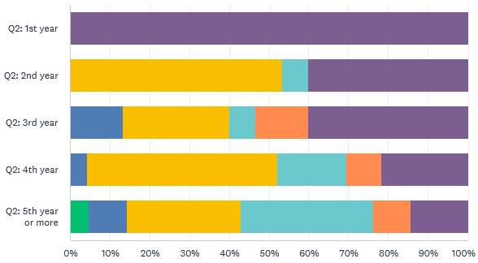
Resolving PhD Salary Ladder Issues (data)
Correlation by year a PhD student is in:
Yes, and I was given support
Yes, and this didn't solve anything
No, I thought it wouldn't solve the issue / I didn't want to bother with it
No, I did not know they could help me
No, I do not know who to contact
I'm not a member of a trade union

Slide 29
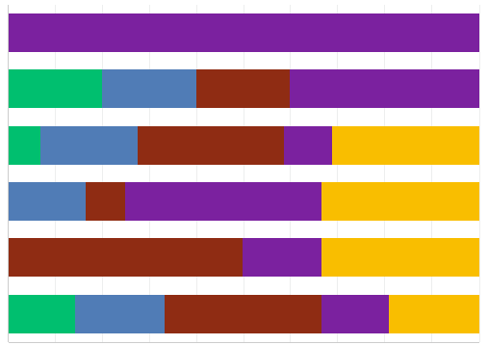
Resolving PhD Salary Ladder Issues (data)
Correlation by school:
ABE
CBH
EECS
ITM
SCI
Yes, and I was given support
Yes, and this didn't solve anything
No, I thought it wouldn't solve the issue / I didn't want to bother with it
No, I did not know they could help me
No, I do not know who to contact
I'm not a member of a trade union
0
10
20
30
40
50
60
70
80
90
100

Slide 30
Resolving PhD Salary Ladder Issues (analysis)
Nearly 30% of all students on the PhD salary ladder (including first years) have experienced trouble moving up the ladder
Main reasons reported are neglect or push back from supervisors
Students do not reach out for help because they do not think it will help
As nearly 40% of 5th year or more doctoral students, still haven’t reached the 4th step of their PhD salary ladder, students are getting stuck in comparison to their study time
Q19: leave a commentary if you desire.
28 responses
Summary of comments:
Delay because of difficulty to get the requirements
Students were not informed/unaware of the PhD Salary process
Supervisors neglecting this process

Slide 31
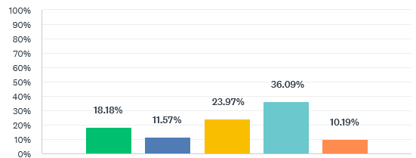
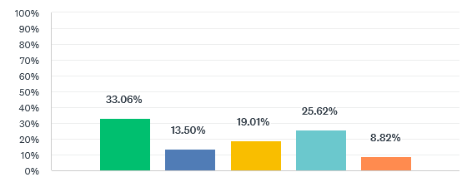
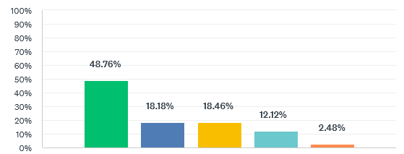
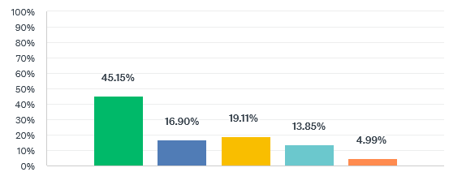
How to modify salary ladder (data)
Num submitted papers (either conferences or journals):
Numb completed credits:
Don’t include
Neutral
Include
Don’t include
Neutral
Include
Num published papers (either conferences or journals):
Numb accepted papers (either conferences or journals):
Don’t include
Neutral
Include
Don’t include
Neutral
Include

Slide 32
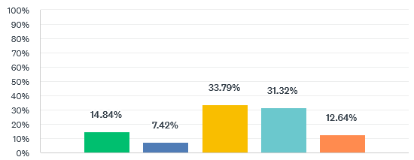
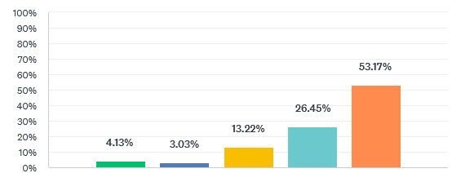
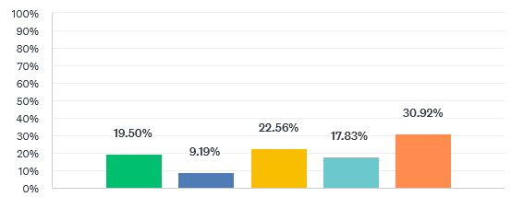
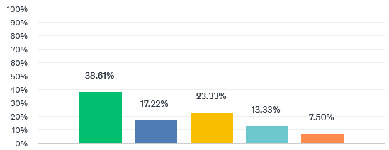
How to modify salary ladder (data)
Time (i.e., from when you started the PhD):
Presentation of a public seminar:
Include
Don’t include
Neutral
Include
Neutral
Don’t include
The criteria should be tailored to the student:
My supervisor should have the discretion to decide when I advance:
Include
Don’t include
Neutral
Include
Don’t include
Neutral

Slide 33
Resolving PhD Salary Ladder Issues (data)
Q28: leave a commentary if you desire.
61 responses
Summary:
The advancement in the PhD salary ladder should not be up to the PhD Supervisor
Having number of credits/papers as criteria to move up the salary ladder will lead to different progression rates for PhD students depending on ‘luck’ factors (such as: research field, project, PI, etc.)
Time seems to be the most fair criteria

Slide 34
Resolving PhD Salary Ladder Issues (analysis)
~53% of the PhD students think that time should be included as criteria from comments and overall grades, a time based PhD ladder is clearly favoured by the students.
~39% of the students think their supervisor should not decide when they get to move up on the PhD salary ladder and from the responses it seems that some students think that this gives them too much power which could lead to potential abuse of the students
~31% of the students think that the criteria should be tailored to the student
Students seem quite positive about having amount of credits or a public seminar as criteria
Students are less keen on having papers as a criteria, especially not either accepted or published papers. Submitted papers has the highest grade of these criteria.

Slide 35
Vacation and Sick leave

Slide 36
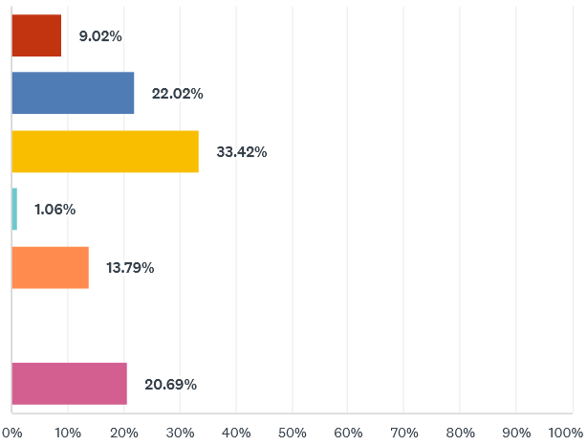
Vacations and Sick leaves (data)
Q29: In 2023, how many vacation days did you effectively use (i.e., not counting national holidays)?
Less than 15 days
Between 15 to 20 days
Between 25 to 35 days
More than 35 days
I don’t keep track of my vacation days
I’m a first year student
I’m a first year student/ I started my PhD in 2024

Slide 37
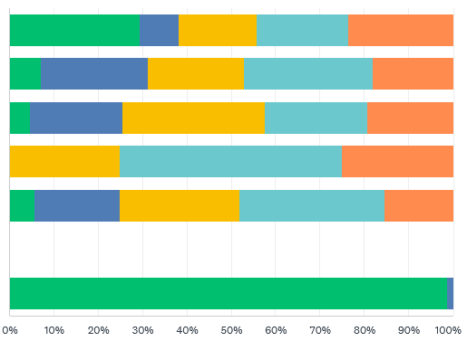
Vacations and Sick leaves (data)
Correlation by year a PhD student is in:
1st year
2nd year
3rd year
4th year
5th year or more
Less than 15 days
Between 15 to 20 days
Between 25 to 35 days
More than 35 days
I don’t keep track of my vacation days
I’m a first year student
I’m a first year student/ I started my PhD in 2024

Slide 38
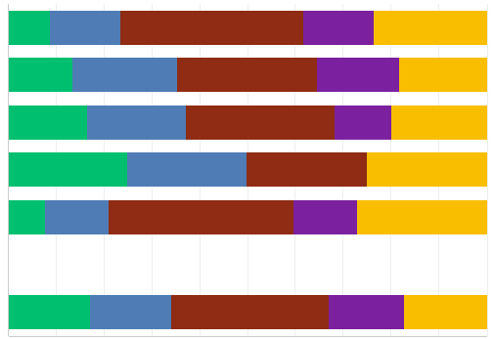
Vacations and Sick leaves (data)
Correlation by school:
ABE
CBH
EECS
ITM
SCI
Less than 15 days
Between 15 to 20 days
Between 25 to 35 days
More than 35 days
I don’t keep track of my vacation days
I’m a first year student
I’m a first year student/ I started my PhD in 2024
0
10
20
30
40
50
60
70
80
90
100

Slide 39
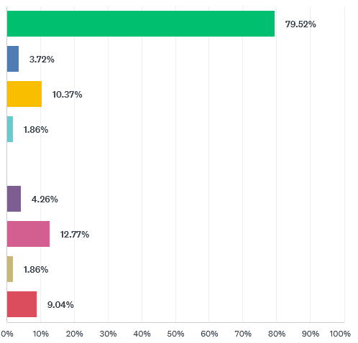
Vacations and Sick leaves (data)
Q30: To whom do you report when you are going to use your vacation days?
My supervisor
My point-of-contact at HR
Head of division
Head of department
Head of school
At an internal system of KTH
I don’t report my vacation days at all
I don’t know
I am a first year student/
I didn’t have the need to report my vacation days so far

Slide 40
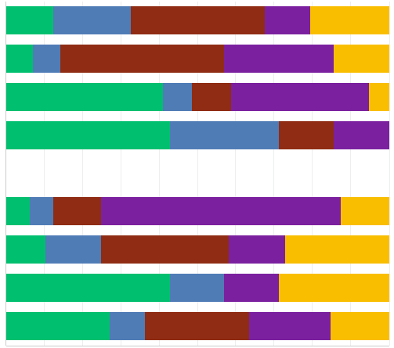
Vacations and Sick leaves (data)
Correlation by school:
ABE
CBH
EECS
ITM
SCI
My supervisor
My point-of-contact at HR
Head of division
Head of department
Head of school
At an internal system of KTH
I don’t report my vacation days at all
I don’t know
I am a first year student/
I didn’t have the need to report my vacation days so far
0
10
20
30
40
50
60
70
80
90
100

Slide 41
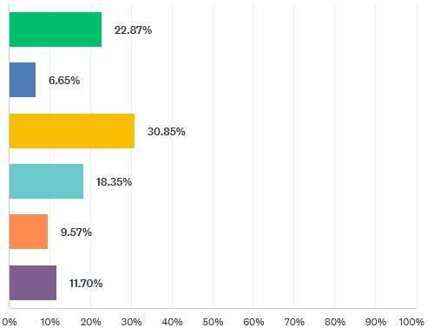
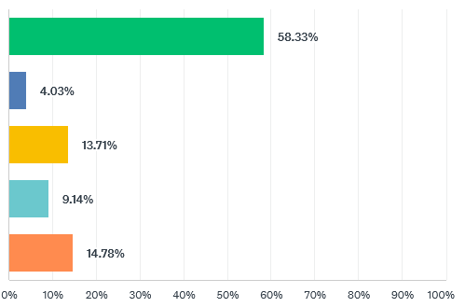
Vacations and Sick leaves (data)
Q31: In 2023, how many days were you sick? (excluding parental leave)
Q32: In 2023, how many sick leaves (excluding parental leave) did you effectively report in total?
None
None
1 day
1 day
2 to 7 days
2 to 7 days
More than 1 week
More than 1 week
I don’t keep track of my sick leaves
I don’t keep track of my sick leaves
Not applicable/ I started my PhD in 2024

Slide 42
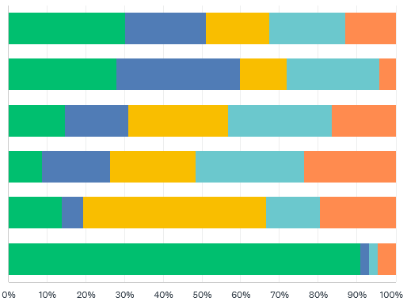
Vacations and Sick leaves (data)
Actual sick days Correlation by year a PhD student is in:
1st year
2nd year
3rd year
4th year
5th year or more
None
1 day
2 to 7 days
More than 1 week
I don’t keep track of my sick leaves
Not applicable/ I started my PhD in 2024

Slide 43
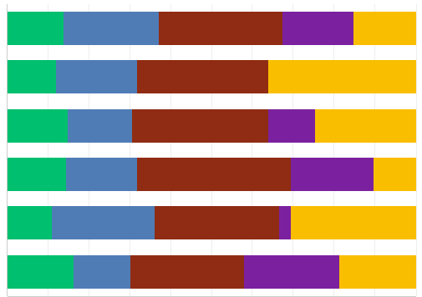
Vacations and Sick leaves (data)
Actual sick days Correlation by school:
ABE
CBH
EECS
ITM
SCI
None
1 day
2 to 7 days
More than 1 week
I don’t keep track of my sick leaves
Not applicable/ I started my PhD in 2024
0
10
20
30
40
50
60
70
80
90
100

Slide 44
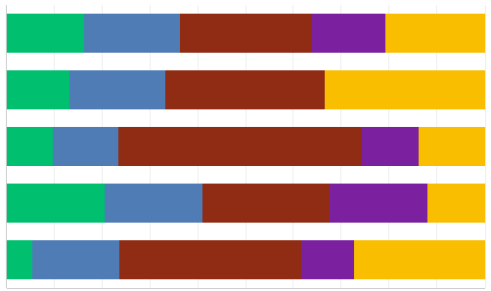
Vacations and Sick leaves (data)
Reported sick days, corralted per school:
ABE
CBH
EECS
ITM
SCI
None
1 day
2 to 7 days
More than 1 week
I don’t keep track of my sick leaves
0
10
20
30
40
50
60
70
80
90
100

Slide 45
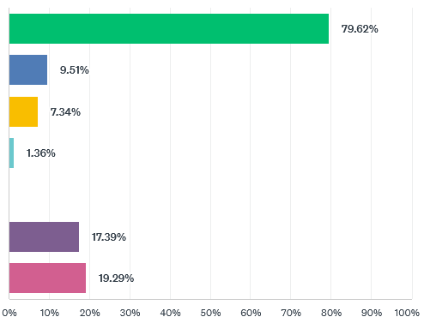
Vacations and Sick leaves (data)
Q33: To whom do you report when you are going to take a sick leave? (select all that apply)
My supervisor
My point-of-contact at HR
Head of division
Head of department
Head of school
At an internal system of KTH
I don’t report my sick leaves at all

Slide 46
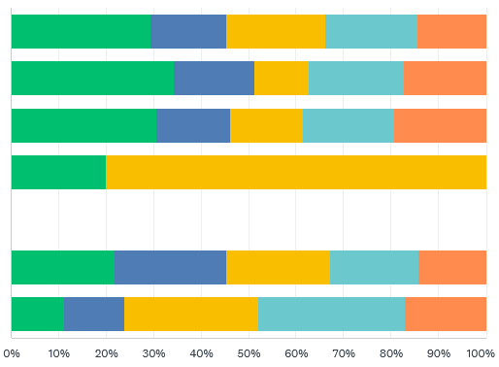
Vacations and Sick leaves (data)
Correlation by year a PhD student is in:
1st year
2nd year
3rd year
4th year
5th year or more
My supervisor
My point-of-contact at HR
Head of division
Head of department
Head of school
At an internal system of KTH
I don’t report my sick leaves at all

Slide 47
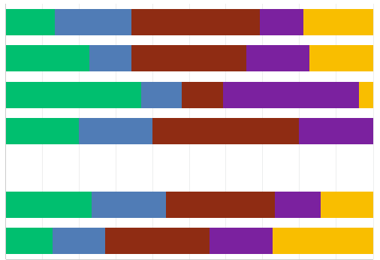
Vacations and Sick leaves (data)
Correlation by school:
ABE
CBH
EECS
ITM
SCI
My supervisor
My point-of-contact at HR
Head of division
Head of department
Head of school
At an internal system of KTH
I don’t report my sick leaves at all
0
10
20
30
40
50
60
70
80
90
100

Slide 48
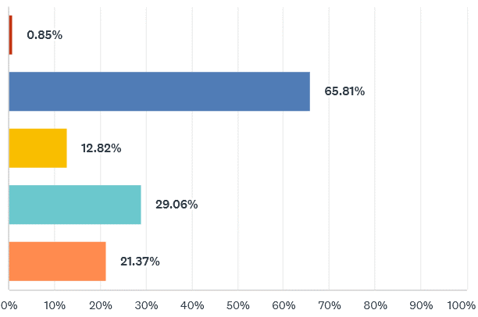
Vacations and Sick leaves (data)
Q34: In a previous question, you mentioned that you took less than 25 days for vacation last year. What are the reasons for it? (Select all that apply)
My supervisor explicitly didn’t let me use all my days
I didn’t have enough time to take it (research papers, project, etc.)
I felt pressure from my peers not to use all my days
I just didn’t want to use all my days
Other (please specify)
Some students experienced pressure from their supervisor, others started somewhere during the year and didn’t have the full amount of vacation days, some students just prefer to get a lot of work done

Slide 49
Vacations and Sick leaves (data)
Correlation by school:
ABE
CBH
EECS
ITM
SCI
My supervisor explicitly didn’t let me use all my days
I didn’t have enough time to take it (research papers, project, etc.)
I felt pressure from my peers not to use all my days
I just didn’t want to use all my days
0
10
20
30
40
50
60
70
80
90
100

Slide 50
Vacations and Sick leaves (data)
30% of all students take less than 20 days of vacation per year and this is a problem at all schools. 70% of the students taking less than 20 days of vacation report the reason being a lack of time due to work load
A majority of students report their sick days and vacation directly do their supervisor.
There is a large discrepency between actual sick days and reported sick days for doctoral students.

Slide 51
PhD Ombudsman

Slide 52
PhD Ombudsman (data)
Correlation by year a PhD student is in:
1st year
2nd year
3rd year
4th year
5th year or more
Yes
Q35: Have you ever requested the services of the PhD Ombudsman at THS?
No
Yes
Correlation by school:
ABE
CBH
EECS
ITM
SCI
No
Yes
No
0
10
20
30
40
50
60
70
80
90
100

Slide 53
PhD Ombudsman (data)
Correlation by school:
Q36: Did the PhD Ombudsman help solving the issue that you brought to her?
ABE
CBH
EECS
ITM
SCI
Yes
Yes
Partly
Partly
No
No
0
10
20
30
40
50
60
70
80
90
100

Slide 54
PhD Ombudsman (data)
Q37: How would you rate the help/guidance/advice that you received?
Q38: How relevant do you feel that the PhD Ombudsman at THS is for doctoral students?
Very bad
Neutral
Very good
Very bad
Neutral
Very good

Slide 55
PhD Ombudsman (data)
Q39: Would you recommend the PhD Ombudsman at THS to other students?
Q40: leave a commentary if you desire.
8 responses
Yes
Summary:
Most students were satisfied with the help they have gotten
Some students felt like they didn’t get enough help, but would still recommend her service
No

Slide 56
PhD Ombudsman (analysis)
Around 8% of PhD Students have utilized the PhD Ombudsman
Even though most students experienced that the PhD Ombudsman could only partly solve their problem, nearly all of them strongly recommend the PhD Ombudsman for other students.

Slide 57
Reception, On-boarding, Chapter-Hall

Slide 58
Reception and on-boarding (data)
1st year
2nd year
3rd year
4th year
5th year or more
Q41: Has KTH (not THS or the PhD Chapter) offered you an onboarding process when you started your studies? This can be a talk with HR or a small seminar about your life over here?
Yes
No
Yes
ABE
CBH
EECS
ITM
SCI
No
Yes
No
0
10
20
30
40
50
60
70
80
90
100

Slide 59
Reception and on-boarding (data)
Q42: If you started your research studies in July 2023 or afterwards, have you taken part into the Reception organized by THS or the PhD Chapter last year?
Yes
No statistical difference based on school
No
Not applicable

Slide 60
Reception and on-boarding (data)
Q43: How do you rate the onboarding process that you received at KTH?
Very bad
Neutral
Very good

Slide 61
Reception and on-boarding (data)
Q44: Which of these topics were spoken to you during your onboarding? (Select all that apply)
ISP
THS / PhD Chapter
Rights / Obligations as Doctoral Student
Life in Sweden (banking, renting apartment, etc)
Research Advice
Specifics on the PhD program (course, credits, syllabus)
Labour Unions
A-kassa / Unemployment fund
Salary and Taxes
Other (please specify)
Most students don’t remember, some students were offered an onboarding but couldn’t attend

Slide 62
On-boarding (data)
ABE
CBH
EECS
ITM
SCI
Correlation by school:
ISP
THS / PhD Chapter
Rights / Obligations as Doctoral Student
Life in Sweden (banking, renting apartment, etc)
Research Advice
Specifics on the PhD program (course, credits, syllabus)
Labour Unions
A-kassa / Unemployment fund
Salary and Taxes
0
10
20
30
40
50
60
70
80
90
100

Slide 63
Onboarding – How was the process (analysis)
General trend of improvement in recent years with the number of students receiving on-boarding, but still over 40% of total students did not receive any on-boarding from KTH
Nevertheless, there is room for improvement
ITM and CBH schools have less exposure to onboarding events

Slide 64
PhD Chapter Hall – Attendance (data)
Q45: Have you ever been to any event (PhD Pubs, Karaoke Nights, WoP, etc) organized by the PhD Chapter at the PhD Chapter Hall ("T-Centralen")?
ABE
CBH
EECS
ITM
SCI
Yes
Yes
No
No
I didn't know we had a Chapter Hall
I didn't know we had a Chapter Hall
0
10
20
30
40
50
60
70
80
90
100

Slide 65
PhD Chapter Hall – Attendance (data)
No significant differences between schools
Q46: Did you know that you could use the PhD Chapter Hall for studies or research during daytime?
5th year or more
1st year
2nd year
3rd year
4th year
Yes
Yes
No
No
I didn't know we had a Chapter Hall
I didn't know we had a Chapter Hall

Slide 66
PhD Chapter Hall – Attendance (data)
Q47: Do you think that T-Centralen is a suitable place for study activities?
Worst
Average
The best

Slide 67
PhD Chapter Hall – Attendance (data)
Q49: Have you used our Chapter Hall during day time for study/research-related activities?
Yes, and I still frequently use it
Yes, but I didn't really like it
No, but I would try if I had card access
No, and I would not because the office space suffices for me.

Slide 68
PhD Chapter Hall – Attendance (data)
Q48: How do you rate the events offered by the PhD Chapter at our Chapter Hall?
Really bad
Average
Really good

Slide 69
PhD Chapter Hall – Attendance (data)
Q50: leave feedback on how to improve usage of the Chapter Hall
43 responses
Summary:
Students didn’t know the place was used for studying/think the place is not suitable for studying
Students would like more events
Some suggestions: serve food during pubs, have an exchange bookshelf

Slide 70
PhD Chapter Hall (analysis)
A majority of students who responded to the Survey have been to events at the PhD Chapter Hall. We should note that students who attend events are also more likely to respond to a Survey from the PhD Chapter.
Around 40% of students did not know that the Chapter hall can be used for studies, but a majority do not require this since their office space suffices. 20% would attempt to study at the Chapter Hall if they had access.
Overall very positive review of the events organised by the PhD Chapter in the PhD Chapter Hall.

Slide 71
Branding and Perception (data)
Q51: Please rate how do you perceive the work done by the PhD Chapter (including councils) towards doctoral students.
Q52: Please rate how do you perceive the work done by THS Central (excluding the PhD Chapter) towards doctoral students.
They don’t care about doctoral students
Average
I have a high-regard for their work
They don’t care about doctoral students
I have a high-regard for their work
Average

Slide 72
Branding and Perception (data)
Q55: Please rate how do you perceive the work done by KTH as a whole (Management Office, President of KTH) towards doctoral students.
Q54: Please rate how do you perceive the work done by your school towards doctoral students.
They don’t care about doctoral students
Average
They don’t care about doctoral students
Average
I have a high-regard for their work
I have a high-regard for their work

Slide 73
Branding and Perception (data)
Q53: Please rate how do you perceive the work done by Labour Unions (SULF, ST, Sveriges Ingenjör) towards doctoral students at KTH.
They don’t care about doctoral students
Average
I have a high-regard for their work

